Slide 1
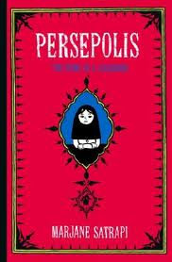
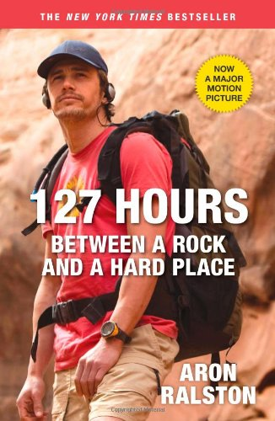
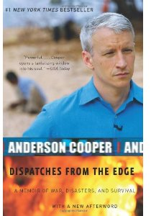

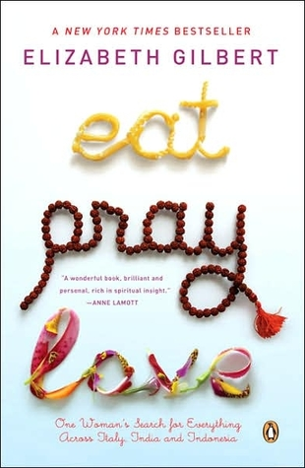
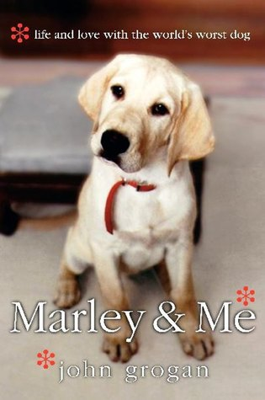
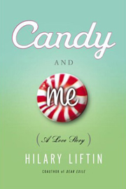
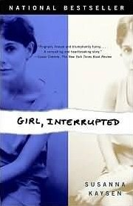

Slide 2
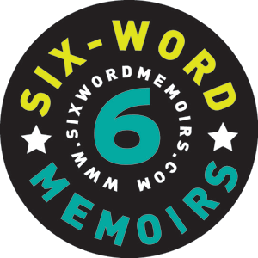
“Say it all
in six
words.”
LIFE SENTENCES: The Six-Word Memoir

Slide 3
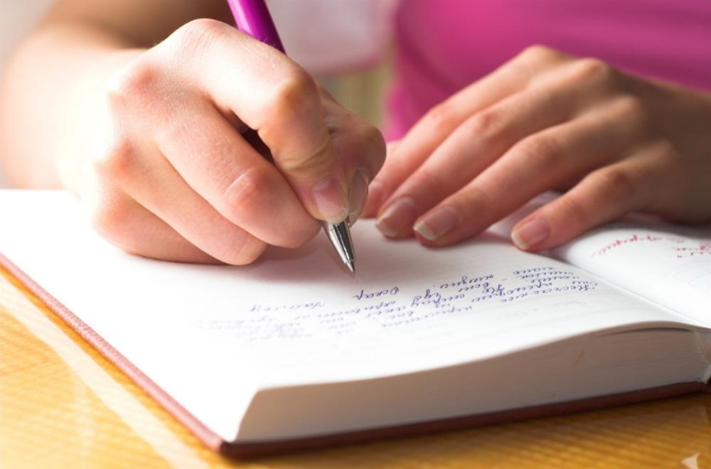

Life: Dream big! Revise. Edit. Repeat.Becky Alfaro
I only tell truth in journals. Sarah White

Slide 4
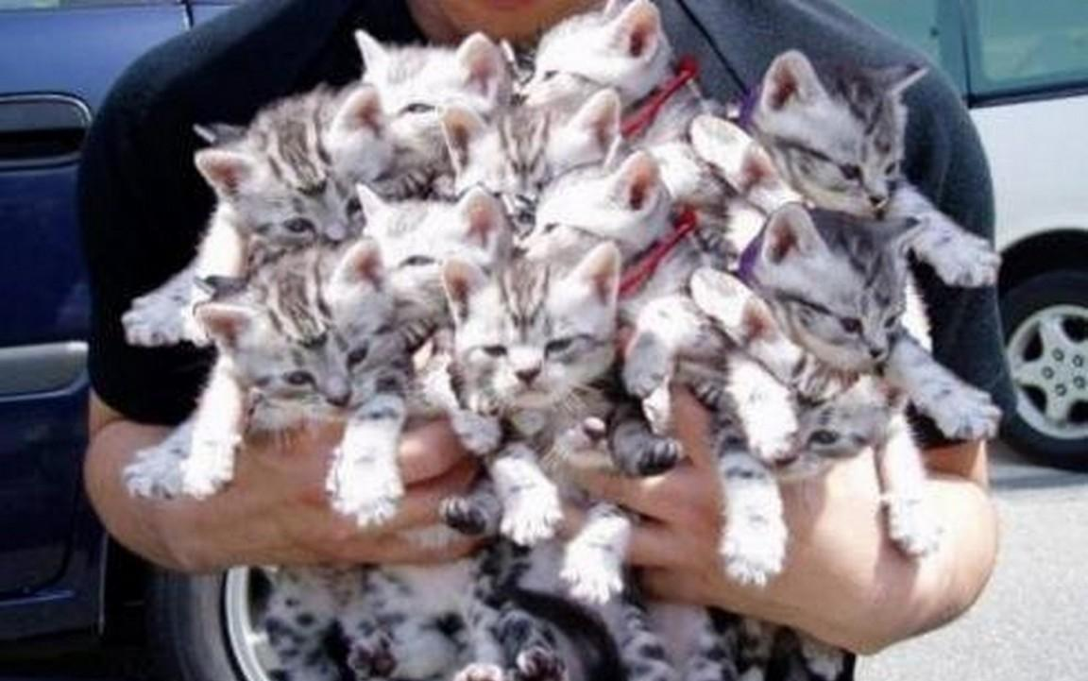
I will be that cat lady. Carol Hardeman

Slide 5
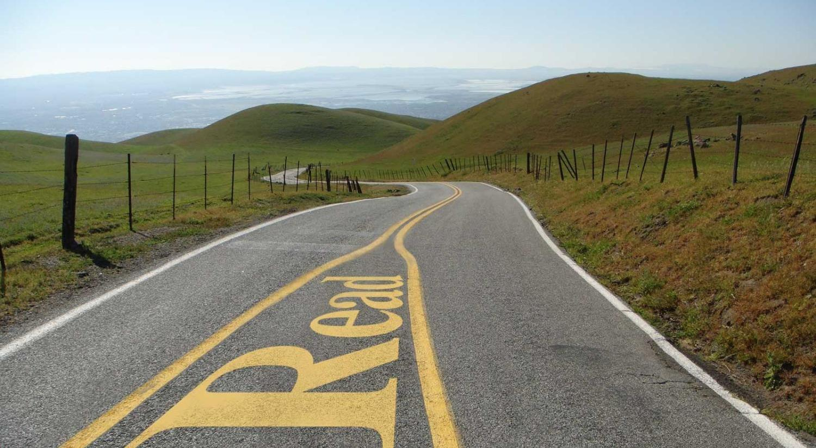
I stopped reading between the lines.
Alix Frank

Slide 6
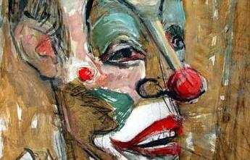
I always imagine clowns without makeup.
Jordan Harris

Slide 7
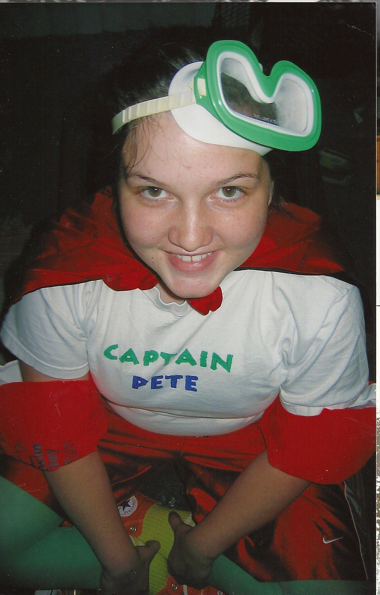
Dreams too big for this town. . .Megan Moore

Slide 8
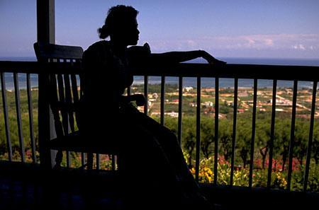
You still smell like my childhood. Caryn Lewis

Slide 9
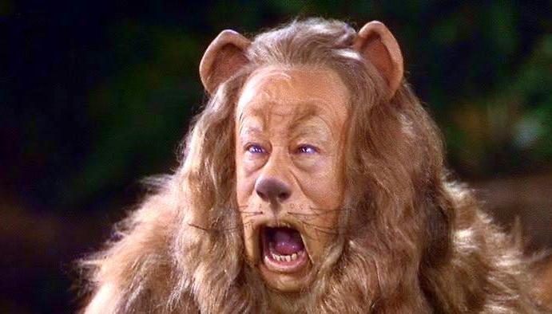
Eccentricity is not an exact science. Nate Foster

Slide 10
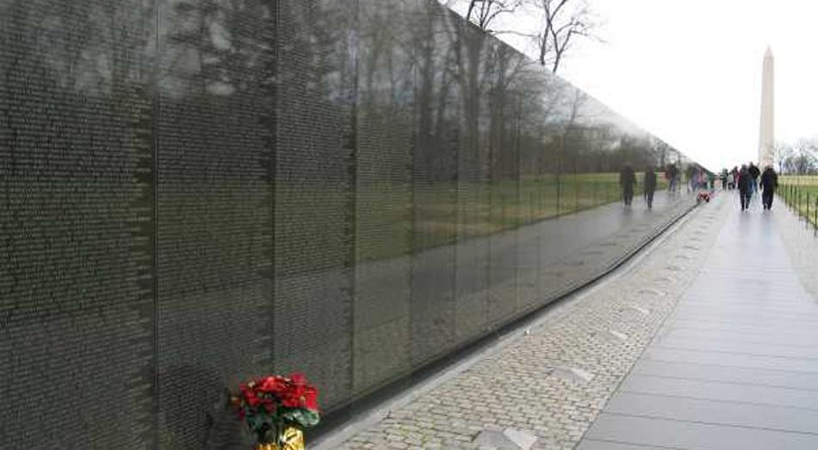
I lost more than my innocence. Mark Lott

Slide 11
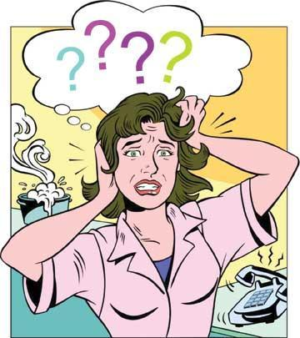
Roots are shallow, wings are broken.
Lori Vicars

Slide 12
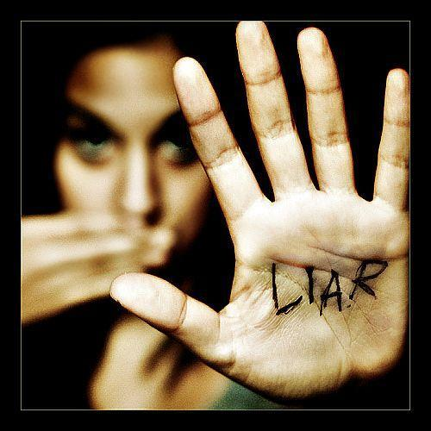
What would we do without liars? Kate Olsen

Slide 13
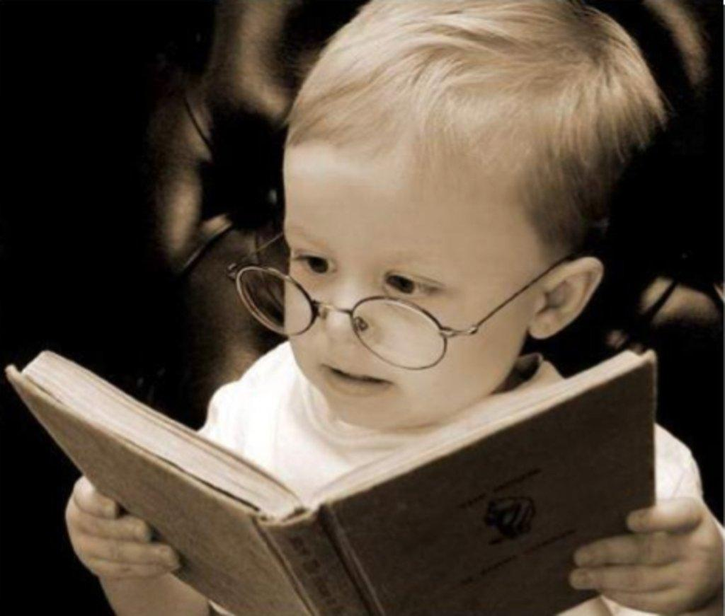
Tired of being the smart kid. Keith Jones

Slide 14
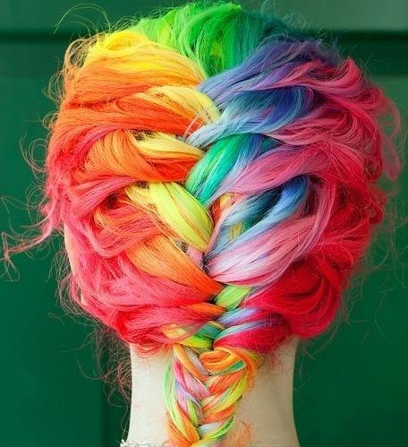
A house without pets isn't home.Jennifer Swedoski
Finally learned “weird” is a compliment. Kathryn Andrews

Slide 15
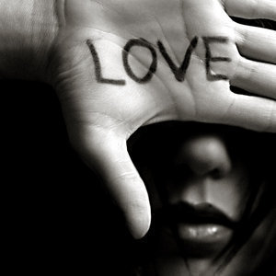
Love hurts, but I’m not broken.
Emma Roberts

Slide 16
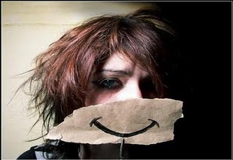
I smile to fool what’s behind. Aaliyah Woods

Slide 17

Missing = Four sisters, four time zones. Lizzy Allred

Slide 18

I love all our random conversations. Isabell Pelley

Slide 19

When you weren’t there, books were. Sean Salas

Slide 20
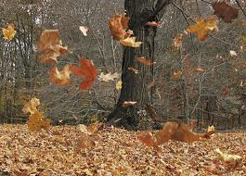
Time passed on. We grew up. Taylor Gauff

Slide 21
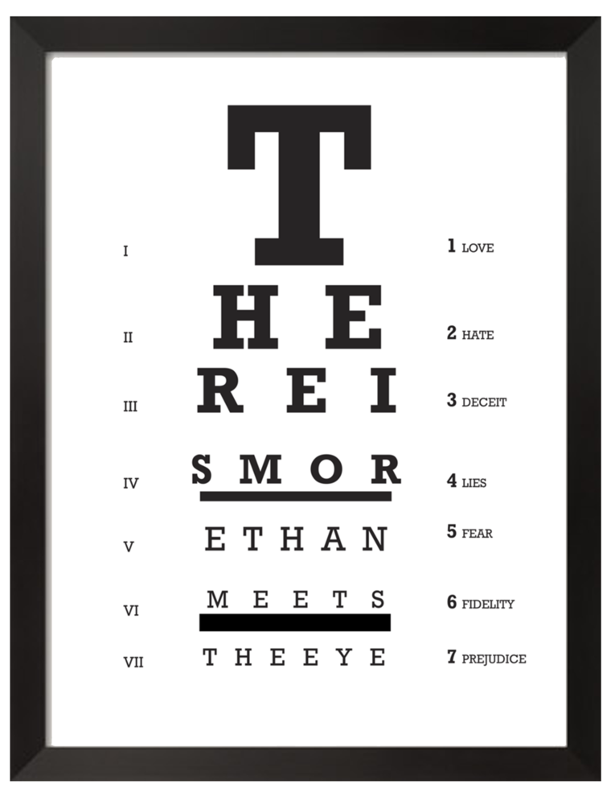
More than just the “nice girl.”
Shannon Byrnes

Slide 22
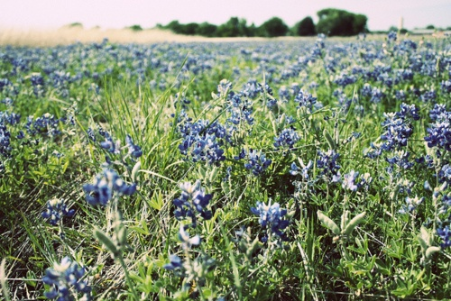
5402 miles away from my home. Megan Mullen

Slide 23

In honor of my dad, I devote the following memoir.
Drained his strength, not his will. Drayce Howard

Slide 24

Not enough room in the margins. Helen Thomas

Slide 25
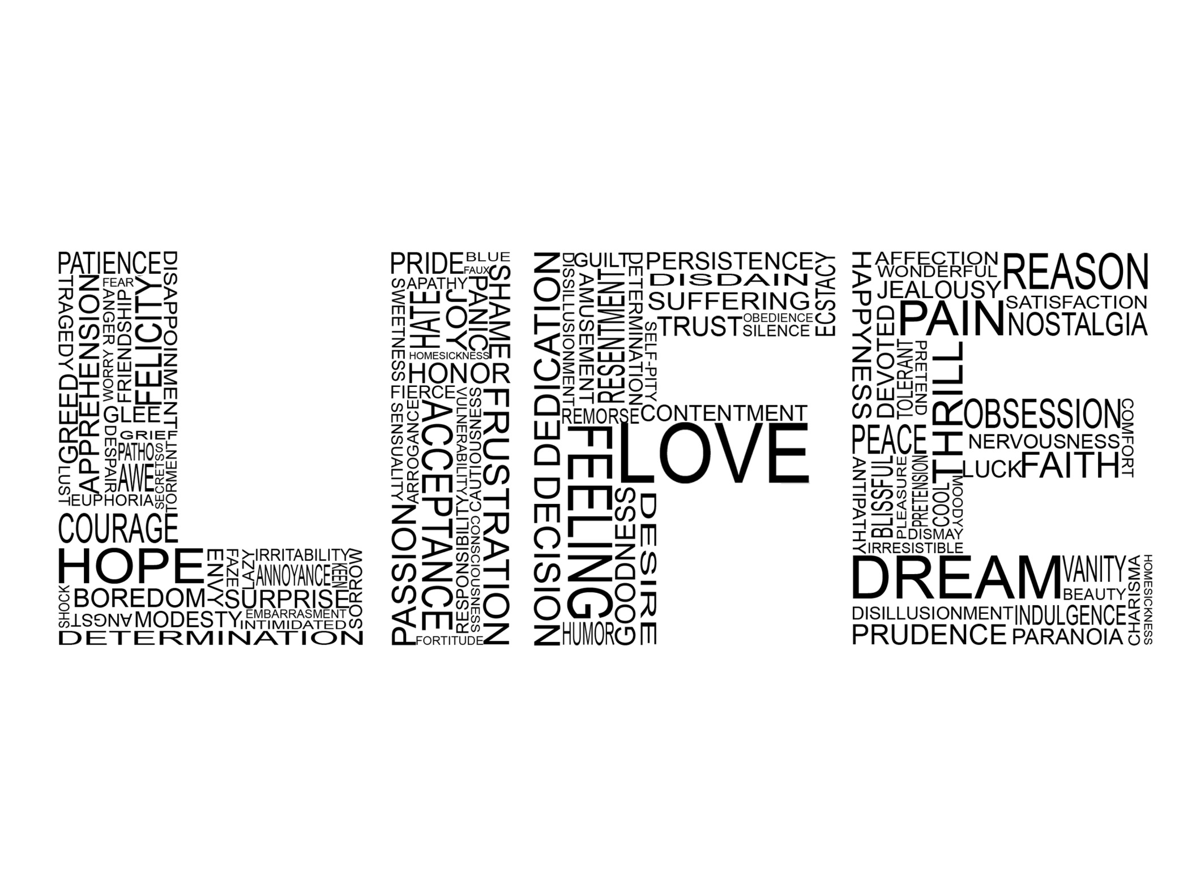
Six words don’t determine my life.
Kayli Rembert

Slide 26
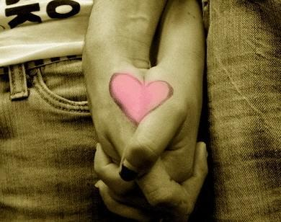
Followed the rules. Wished I didn’t. Rina Rodriguez

Slide 27
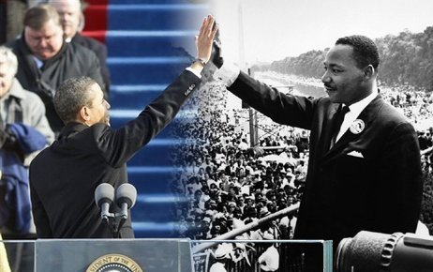
Live by your beliefs and go. Romina Fears

Slide 28
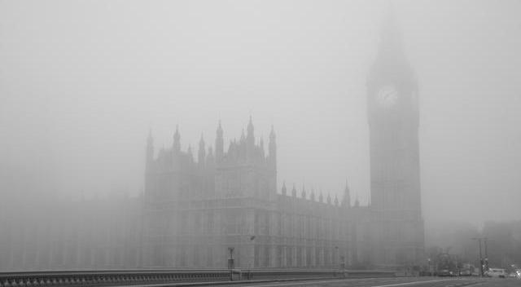
London – walked around in a fog.
Barry Saunders

Slide 29
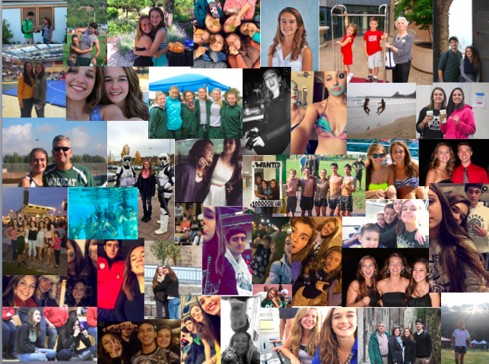
Six words will never define me.
Katye Cairns

Slide 30
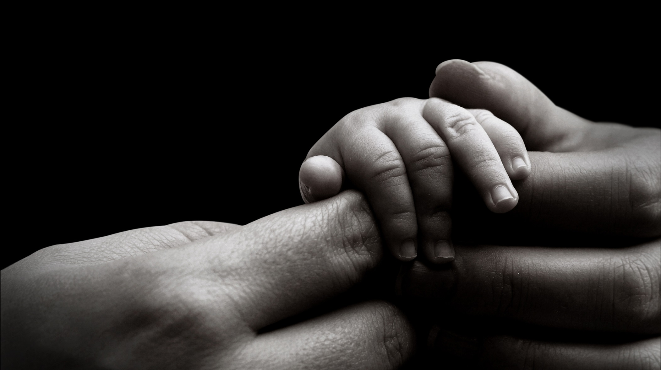
Adopted, yes. Unwanted, I think not.
Andrew Smith

Slide 31

Doneness counts, but not done yet. Sandra Effinger
Doneness counts, but not done yet.
Sandra Effinger

Slide 32
Discussion Question
How is it both possible and impossible to distill the essence of who you are into six words? Which of these authors do you think did the best job of it and why?

Slide 33
Put your six words here, please.
First Last

Slide 34
Six words don’t determine my life.
Kayli Rembert

